Slide 1
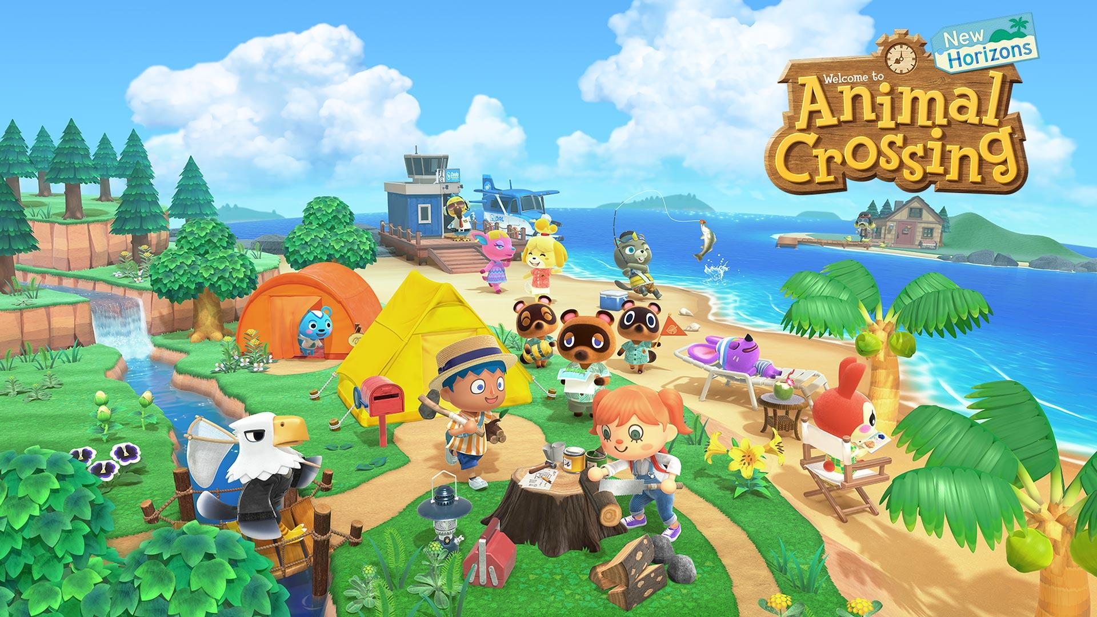
DATA-DRIVEN APPROACH TO VILLAGER POPULARITY
WITHIN ANIMAL CROSSING NEW HORIZONS
W200 Spring 2021
Karl Eirich, Tina Hsieh, Kasha Muzila
Notes:
Good evening everyone,
My name is Kasha, and along with my colleagues Tina and Karl, we are here to talk to you tonight about our analysis on a data-driven approach to villager popularity within Animal Crossing New Horizons. We found some interesting things within this analysis and we would like to share what we found with you. Let’s get started.
Image source: https://www.nintendo.com.au/catalogue/animal-crossing-new-horizons

Slide 2
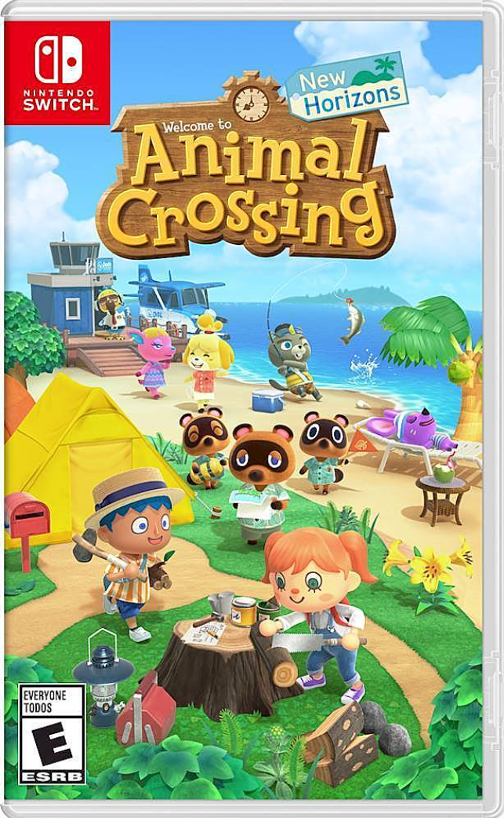
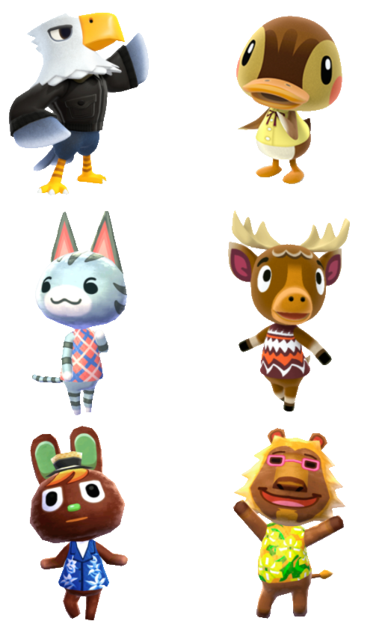
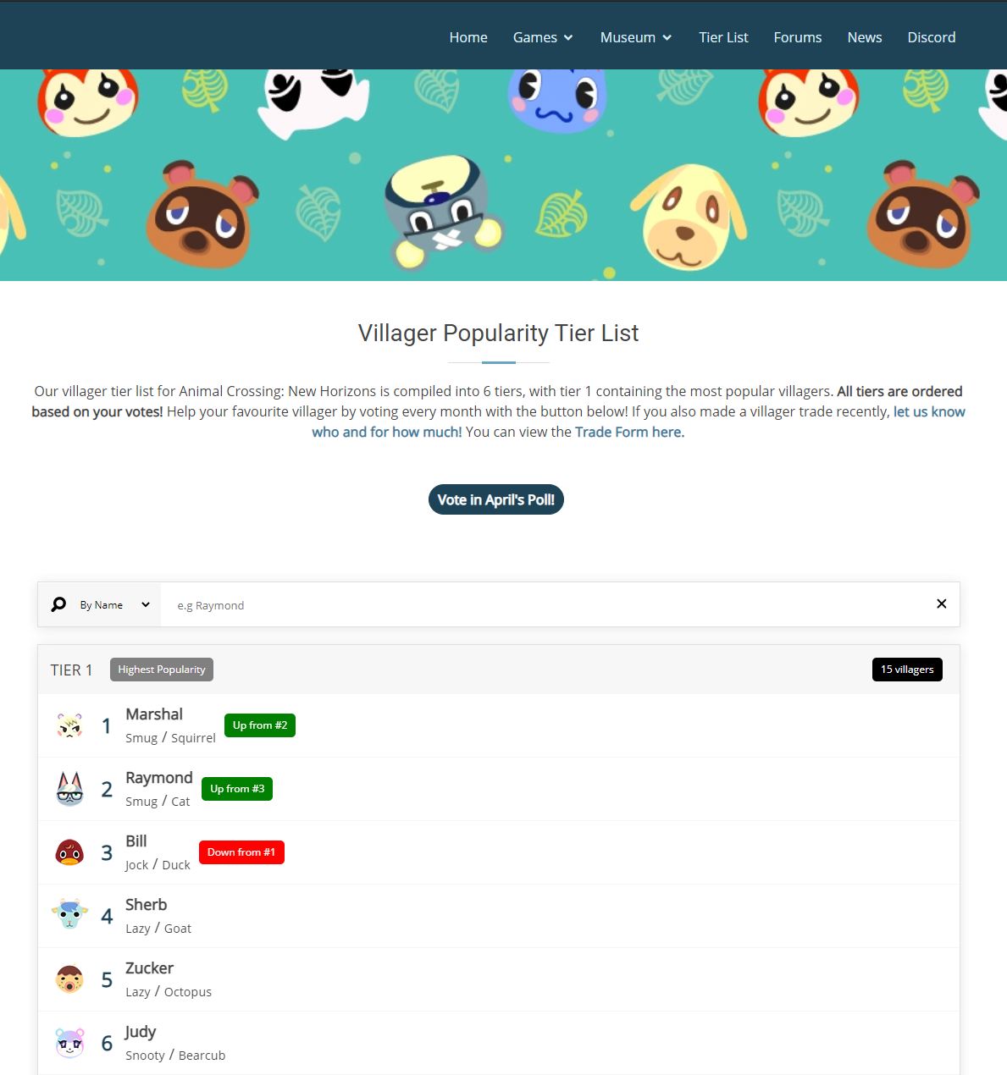
Overview
Villagers
Public Forum
Notes:
In the year 2020, Nintendo released a new game called "Animal Crossing: New Horizons." During the first few months of its release, this game became very popular, primarily due to the pandemic and its unique way of creating a community of people based on characteristics within the game. These characteristics range from villager popularity to catching rare items. However, we will only focus on villager popularity and correlations that could cause the villager's popularity for this analysis.
A villager is a non-player character (NPC) within the game that interacts with the player, items, or events. There are about 400 villagers that the player can have, and they range from different animal species and personalities.
Many public forums give rankings per month on which villager is the most popular. However, these public forums mostly go off of survey-based data in order to do these rankings. They do not look into other causes on why a particular villager would be more popular over another. Our analysis will explore in-game data and scraping Twitter to determine if other correlations cause a villager's popularity.
Image sources:
https://www.reddit.com/r/AnimalCrossing/comments/fc88vp/in_response_to_uilleniel32_here_are_my_top_9/
https://www.animalcrossingportal.com/games/new-horizons/guides/villager-popularity-list.php#/
https://www.bestbuy.com/site/animal-crossing-new-horizons-nintendo-switch/5723316.p?skuId=5723316

Slide 3
Key Terms
Popularity -- The amount that the villager is talked about, whether favorable for that villager or unfavorable.
Villager -- A non-player character (NPC) within the game that interacts with the player, items, or events.
In-game data -- Data that was directly pulled from Animal Crossing: New Horizons
Notes:
Some key terms that we will be using throughout this presentation are:
Popularity -- The amount that the villager is talked about, whether favorable for that villager or unfavorable.
Villager -- A non-player character (NPC) within the game that interacts with the player, items, or events.
In-game data -- Data that was directly pulled from Animal Crossing: New Horizons

Slide 4
Focusing Questions
What in-game information should we know about villagers and that could influence their popularity?
Are there any correlations between game events and villager popularity by scraping tweets about villagers from Twitter?
Notes:
Our focusing questions divide our report into 2 sections: in-game information that could influence villager popularity and a deeper look into villager popularity from Twitter and in-game events.
Now, I’ll hand it over to karl, who will discuss the specifics of our data.

Slide 5
Dataset
Game Data:
35 datasets total
Main datasets:
Twitter Data:
596K tweets total
Date Range:
March 2020
April 2021
Hashtags:
#AnimalCrossing
#ACH
Villagers | Tools
Recipes | Dress-up
Housewares | Headwear
Wall-mounted | Wallpaper
Miscellaneous | Seasons and Events

Slide 6
Data Validation and Preparation
Validation -- We validated data by comparing how players obtain recipes from different villager personalities.
Preparation -- We merged our villager dataset with various in-game asset information that could be correlation with a villagers popularity, such as recipes or items.

Slide 7
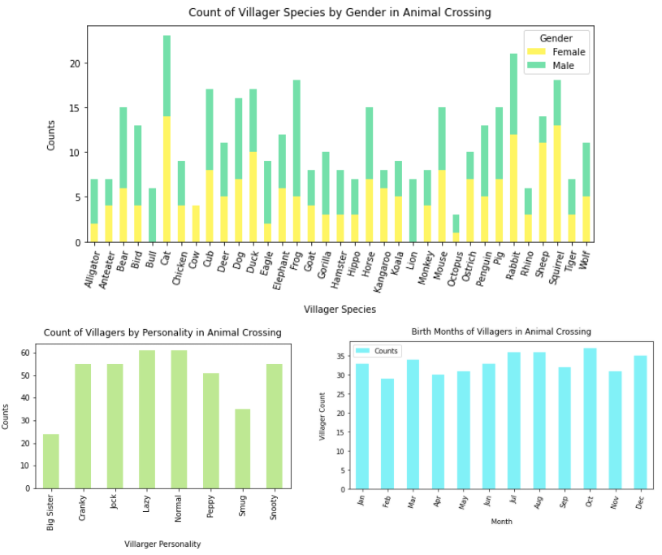
Exploratory Questions
Initial analysis of Animal Crossing villager data shows that most their attributes are well distributed
Notes:
We wanted to explore in-game data that would give us more background information about villagers we might need to know before scraping Twitter for any more correlations in their popularity with in-game events. The first thing that we looked into was how many villagers and villager species were there in the game. We found that there are a total of 397 villagers and 35 species

Slide 8



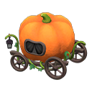
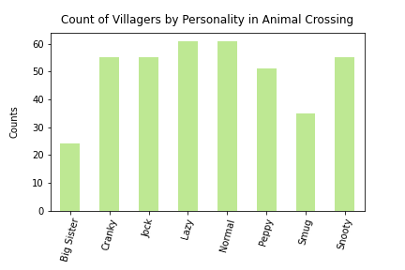
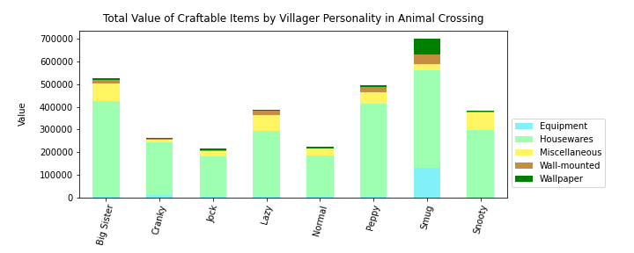
Villagers & In-Game Items
Focus on the value of items players can receive from different villager personalities
A potential correlation with villager popularity:
The smug villager personality gives the most valued items to players
Notes:
Thank you Karl!
As Karl mentioned, every villager has a personality. In Animal Crossing, villagers give players items that they can store in their house or sell to the market. Based on villagers’ personalities, they give different kinds of items ranging from equipment to furniture. So, we wanted to analyze which villager personality would give a player the most value in items. Comparing the two graphs here, we can see that smug villagers and big sister villagers are rare than other personalities, but they tend to give players more valuable items, especially the smug villagers. This could be a reason why a particular villager is more popular since every player’s initial goal is to accumulate money rapidly and pay off the debt.

Slide 9

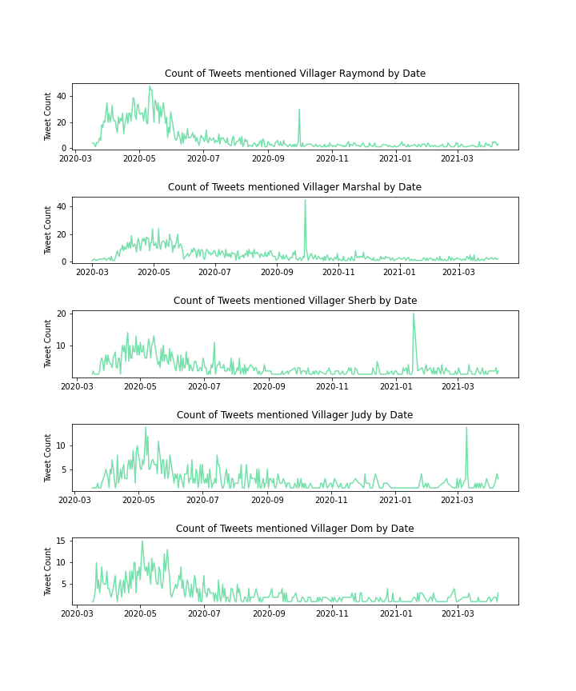



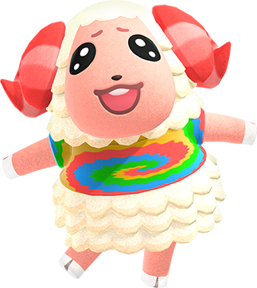
Top 5 Villagers on Twitter
Focus on tweets with villagers’ name by date to understand their popularity
3
Sherb (Lazy)
1
Raymond (Smug)
4
Judy (Snooty)
2
Marshal (Smug)
5
Dom (Jock)
Sudden spikes in the top 4 villagers’ twitter trend charts throughout the year
Notes:
Players often tweet about their favorite villagers by mentioning the villagers' names or posting images. We decided to focus on tweets with villagers' names to understand their popularity. Going through some initial exploratory analysis and trial rounds helped us refine the rules, eliminate noises and get relevant results to answer our questions.
Top 5 villagers. Smug villagers related to the in-game items.
We then wanted to analyze the top 5 villager tweets to see if they had any abnormalities that could have caused them to be more popular during certain times after the game's release. The time-series graphs offered a clear visualization of the trends based on tweets' count with these top 5 villagers mentioned.
We can see that all of the top 5 villagers had many tweets about them during the first few months of the game's initial release, and then the tweets started to decrease. However, we can see some spikes for the top 4 villagers in their trend charts.
Image Source: https://animalcrossing.fandom.com/wiki/Animal_Crossing_Wiki

Slide 10
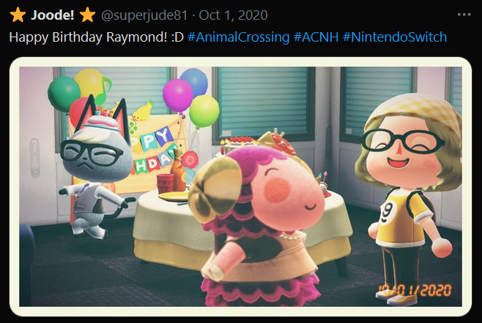
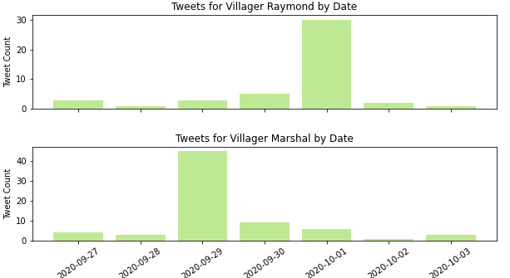
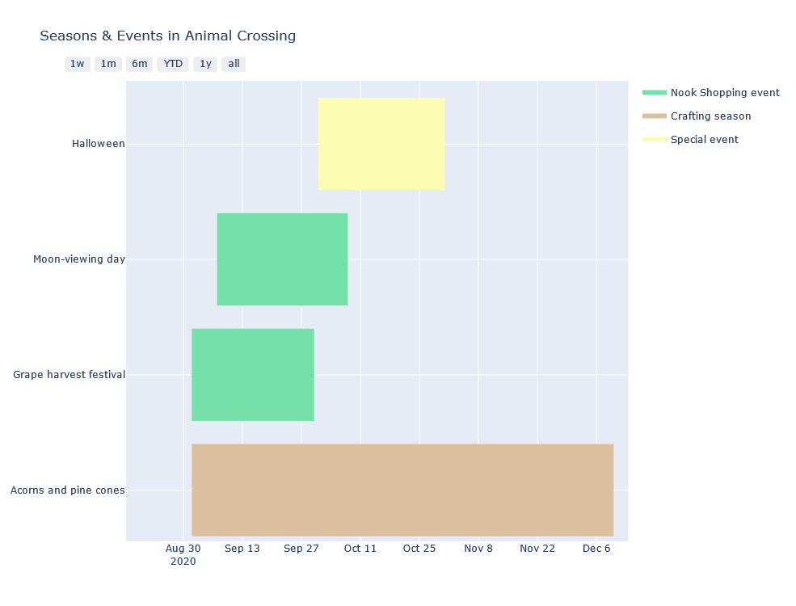

Villager Tweet Spikes
Focus on the tweet count spikes of villager Raymond and Marshal on Sep 29 & Oct 1, 2020
Overall analysis uncovers top popular villagers and a consistent indicator of their popularity with a data-driven approach
Notes:
Further zoom into the villager Raymond and Marshal’s tweet spikes.
To understand what could have caused these spikes, we analyzed all of the in-game season events by creating a Gantt chart using the Plotly library. Plotly is a popular interactive visualization tool, and its create_gantt function enabled us to track the timeline and duration of different events.
Four main events happened during this time period. Looked at keywords and found “birthday”
From here, you can see how Animal Crossing: New Horizons became very popular during the pandemic's early months and has been an engaging and interactive game since its release. Overall, our analysis with in-game and Twitter data uncovers top popular villagers and a consistent indicator of their popularity with a data-driven approach. Thank you!
Image Sources:
https://twitter.com/superjude81/status/1311835003903385600
https://twitter.com/heiheicrossing/status/1311162048923930624

Slide 11
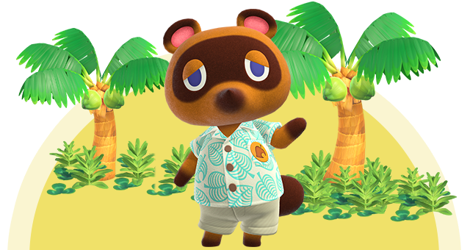
Thank You!
Q & A
Notes:
Image source: https://www.nintendo.com.au/catalogue/animal-crossing-new-horizons

